Slide 1
Landscape Revitalization, Outdoor Education Zones Planning Activity Outcomes
Planning & Resources Council

Slide 2
Planning Outcome Highlights
Landscape Revitalization – Outdoor Education Zones
Supports the GCCCD & GC sustainability efforts.
Helped reduce the colleges water usage (Promote Institutional Effectiveness)
Landscape incorporated into course curriculum (Provide an Exceptional Learning Environment)
Provides a community resource demonstrating native plants and drought tolerant approaches. (Respond to Evolving Community Needs)
Notes:
Tim

Slide 3
Planning Principals and Sustainability Goals
Supports GCCCD Facilities Planning Principles
Provide healthy and comfortable learning and working environments
Support sustainable campus operations
Minimize the use of natural resources and negative impacts to the environment
Meets GCCCD Sustainability Goals
Campuses as Living Laboratories
Be champions of sustainability
Incorporate native/adaptive drought tolerant vegetation

Slide 4
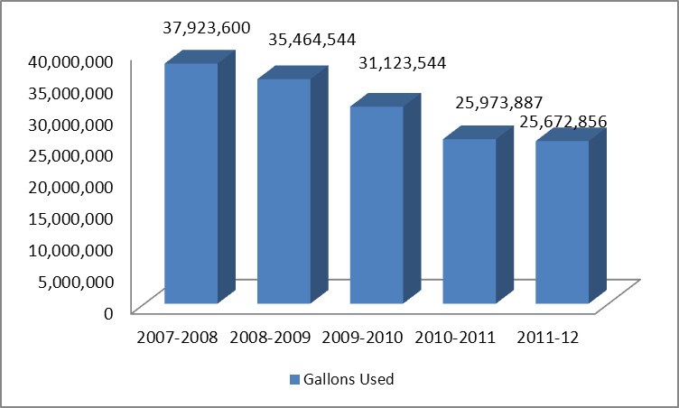
Lowering Costs & Impacts
Helped reduce the colleges water usage (Promote Institutional Effectiveness)

Slide 5
Student Learning Outcomes
Landscape incorporated into course curriculum (Provide an Exceptional Learning Environment)
Geog. 121 includes these specific "native plant gardens" in 5 of its weekly labs, plus as part of 2 exams
Geol. 111, Geog./Geol. 172 through 176(Geology LAB) now utilizes the newly-designed education zones.
Biology 110 used the education zones in 5 sections (190 students).

Slide 6
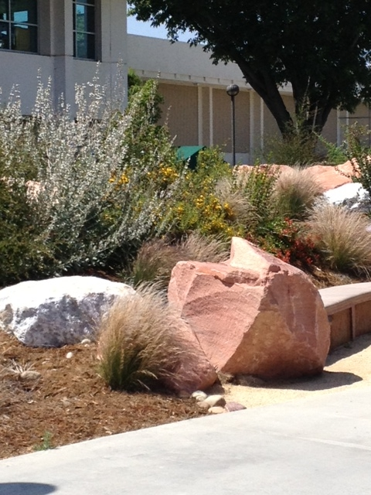
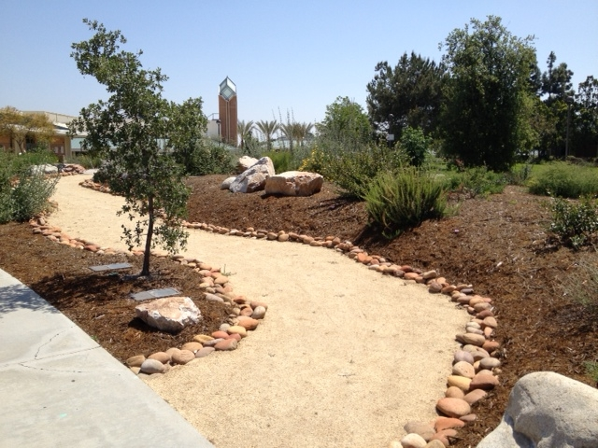
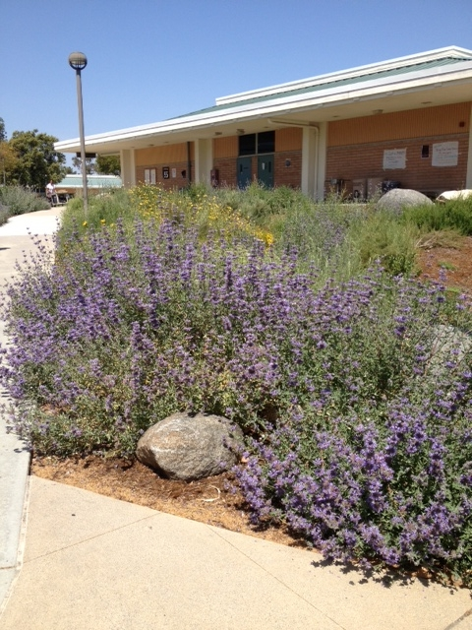
Demonstration & Beautification
Provides a community resource demonstrating native plants and drought tolerant approaches. (Respond to Evolving Community Needs)

